Slide 1
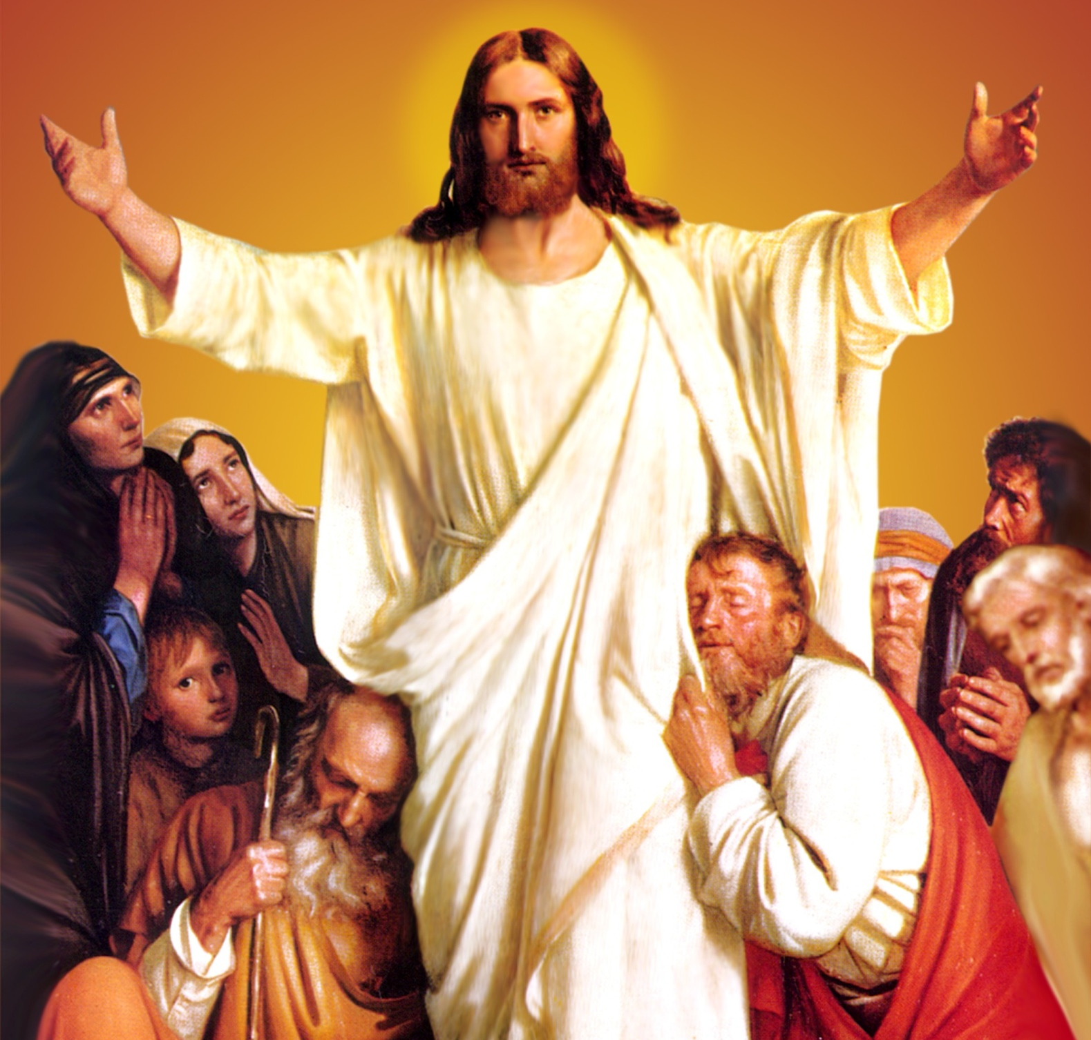
CATECHETICAL TEXTBOOK SERIES OF THE SYRO - MALABAR CHURCH
ON THE PATH OF SALVATION - 6
PEOPLE WHO
EXPERIENCED JESUS
6

Slide 2
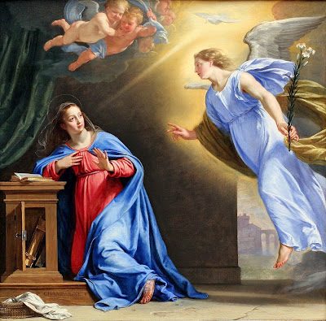
LESSON 1
PROPHESIES ARE FULLFILLED

Slide 3
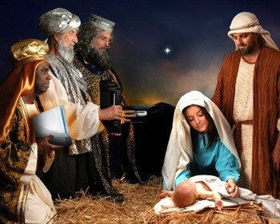
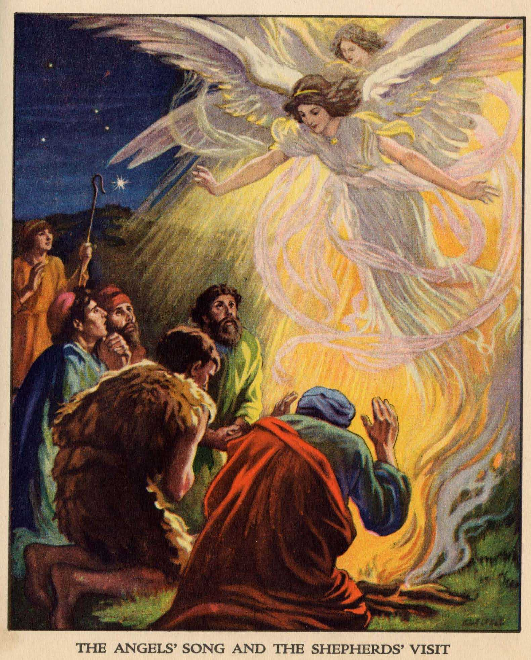
I will put enemity between you and the woman, and between your offspring and herrs. He will crush your head” (Gen3:15).
“ I shall send to them prophet like you, from among their brothers”, God said to Moses.
“ A star shall come out of Jacob, and a scepter shall rise out of Israel”, the prophesy of Balaam.
Messiah would be born of a virgin.

Slide 4
THE ANNUNCIATION TO MARY
HAIL MARY FULL OF GRACE, THE LORD IS WITH YOU

Slide 5
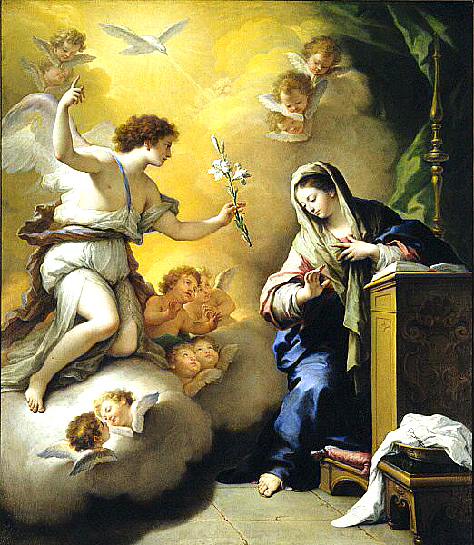
Don’t’ be afraid,
Mary, for God has been gracious to you. You will become pregnant and give birth to a son and you will name him Jesus.

Slide 6
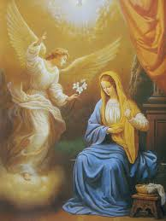
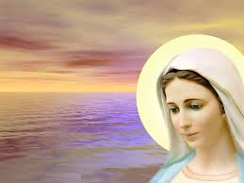
The Holy Spirit will come up on you; therefore the child to be born will be holy , he will be called the son of God
How can this be, since I am a virgin?

Slide 7
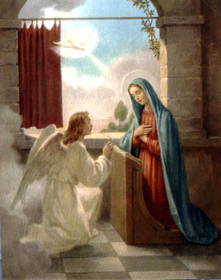
Here I am, the handmaid of the Lord; let it be with me according to your word (Lk.1:38)

Slide 8
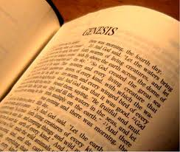
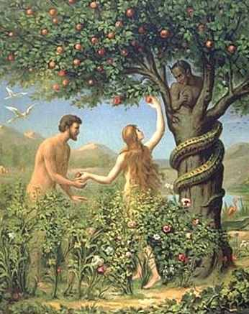
PROPHECIES
I will put enemity between you and the woman and between your offspring and hers. He will crush your head.

Slide 9
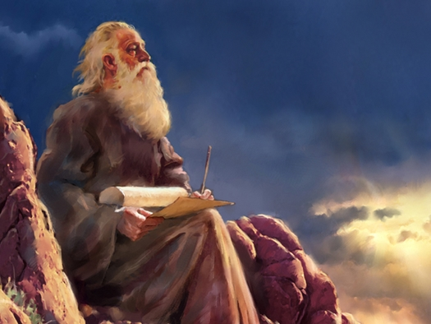
People of Israel awaited this Saviour
Prophesy of Balaam,
“ A star shall come out of Jacob, and a scepter shall rise out of Israel”,

Slide 10
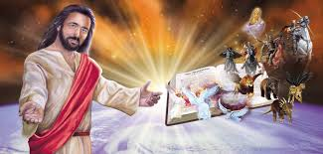
The virgin is with child and shall bear a son, and shall name him Immanuel”, the prophesy of Isaiah (Is. 7:14).

Slide 11
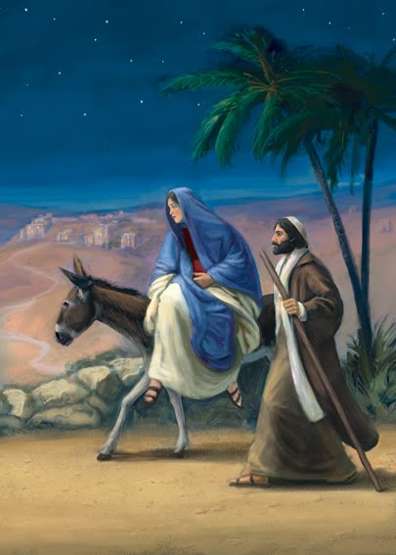
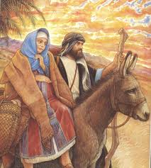
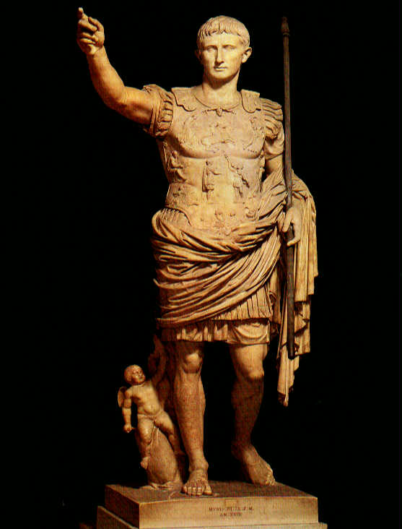
To Bethlehem
There is no place in the Inn.

Slide 12
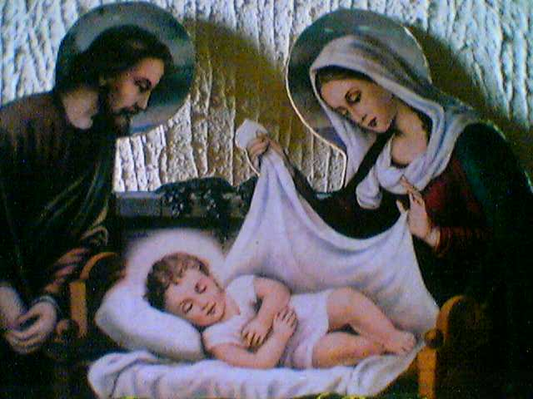
She gave birth to her first born son and wrapped him in bands of cloth and laid him in a manger (Lk.2:1-7)

Slide 13
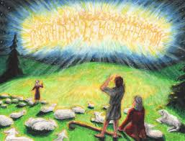
NATIVITY
Do not be afraid; for see I am bringing new of great joy for all the people: to you is born this day in the city of David, a savior who is the Messiah, the Lord. (Lk. 2: 8-11).

Slide 14
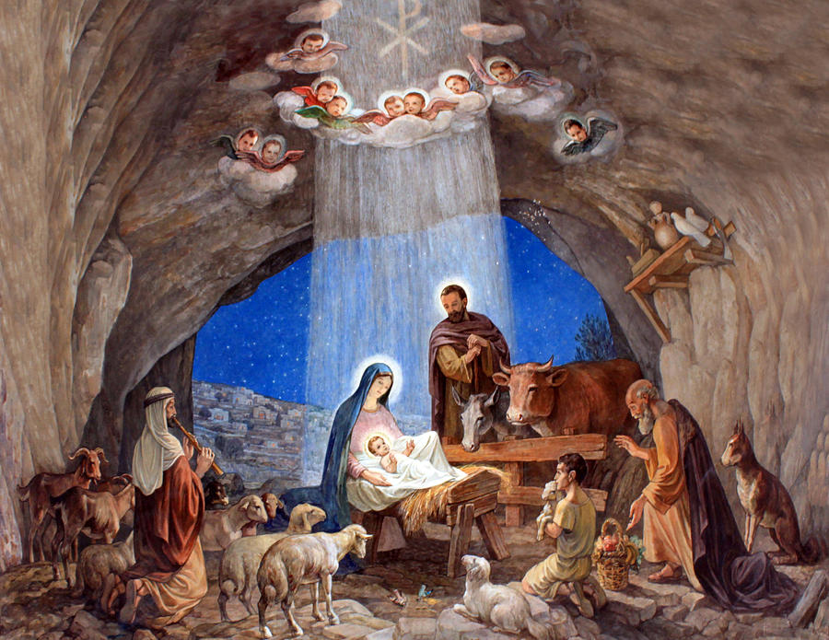
On receiving good new from the angel, the shepherds went in haste to Bethlehem. There they saw Mary and Joseph as well as the infant in the manger, and they glorified God and praised Him
(Lk. 2:15-16)

Slide 15
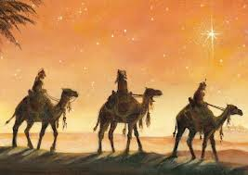
Visit of yhe WISE MEN

Slide 16
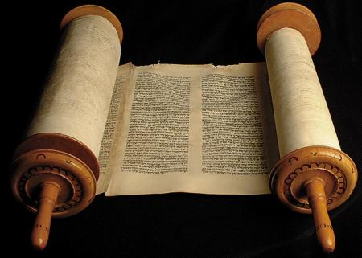
“ And you, Bethlehem,
in the land of Judah, are by no means least among the rulers of Judah, for from you shall come a ruler who is to shepherd my people Israel”.

Slide 17
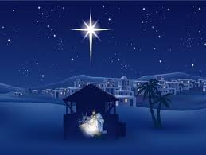
When they saw that the star had stopped, they were overwhelmed with joy.

Slide 18
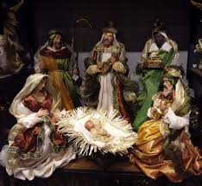
On entering the house they saw the child with Mary his mother, and they knelt down and paid him homage. Then opening their treasure chests they offered him gifts of gold, myrrh and frankincense (Mt. 2:1-12).

Slide 19
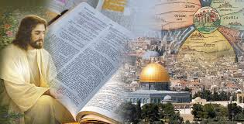
The Year of Christ A.D
At the birth of Jesus the history of the world was divided into two the period before Jesus, B.C. and the period of after Jesus, A.D.

Slide 20
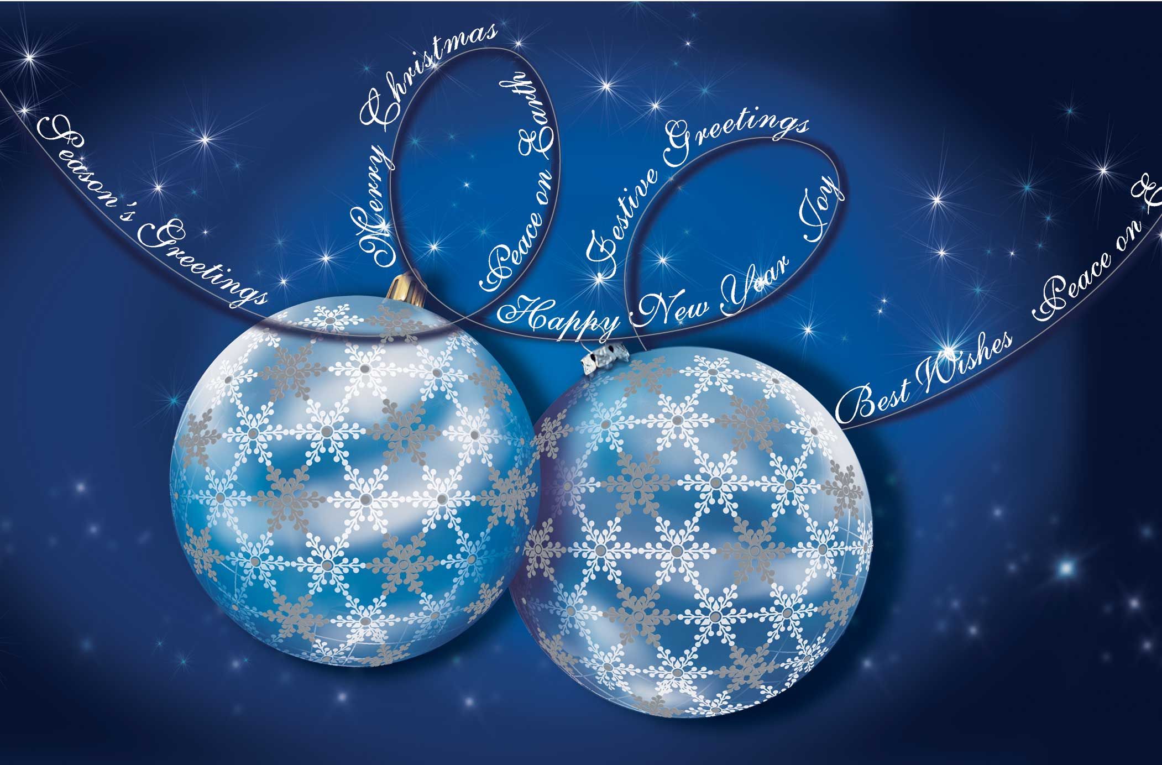
ANNUNCIATION-NATIVITY PERIODS
The first season of liturgical year is that of annunciation which consists of the four weeks in preparation for Christmas. In Syriac, this season is called Subara which means declaration or announcement.

Slide 21
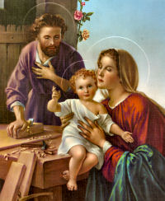
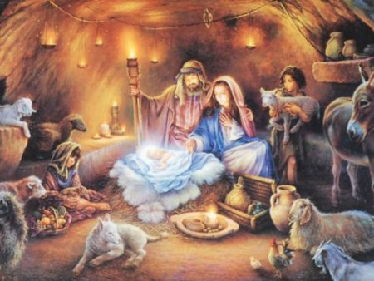
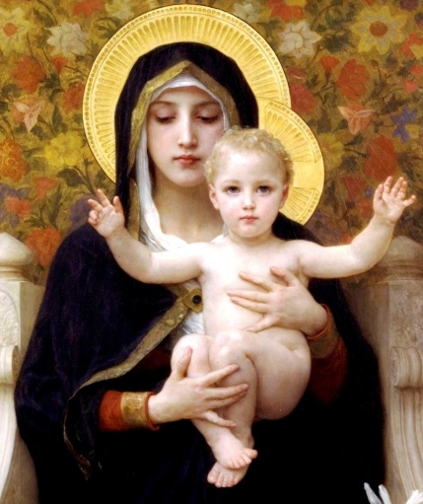
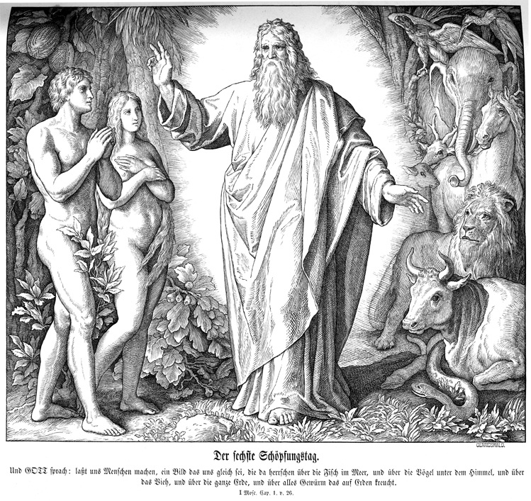
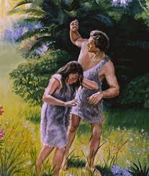
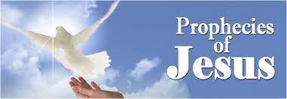
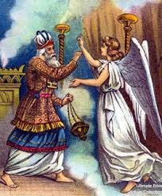
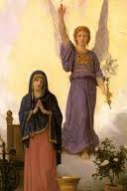
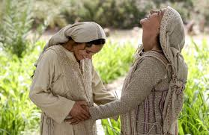
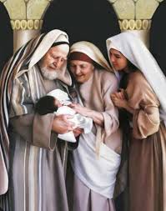
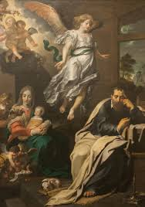
SALVIFIC EVENTS COMMEMORATED
IN THESE SEASONS
ANNUNCIATION
CREATION OF HUMANITY
SIND AND ITS RESULTS
SALVIFIC INTERVENTIONS OF GOD IN THE
OLD TESTAMENT HISTORY
PROPHESIES ABOUT SAVIOUR
ANNOUNCEMENT TO ZACHARIAH
ANNUNCIATION TO MARY
MARY VISITING ELIZABETH
MARY’S SOND OF PRAISE, THE MAGNIFICAT
BIRTH OF JOHN THE BAPTIST
ANNOUNCEMENT TO ST. JOSEPH
NATIVITY
BIRTH OF CHRIST
SHEPHERDS AND WISE MEN VISIT JESUS
NAMING OF JESUS
PRESENTATITION OF JESUS IN TEMPLE
THE HOLY FAMILY OF NAZARETH
THE PRIVATE LIFE
OF JESUS

Slide 22
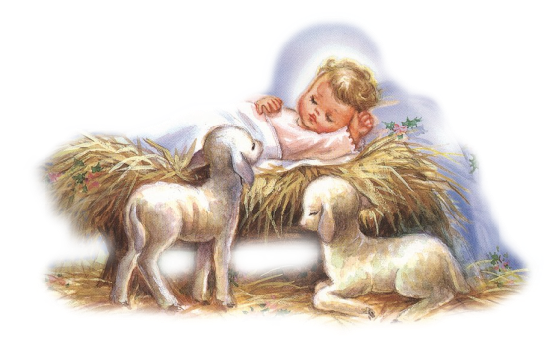
CHRISTMAS
The Birth of Jesus.
Celebrated on 25th December

Slide 23
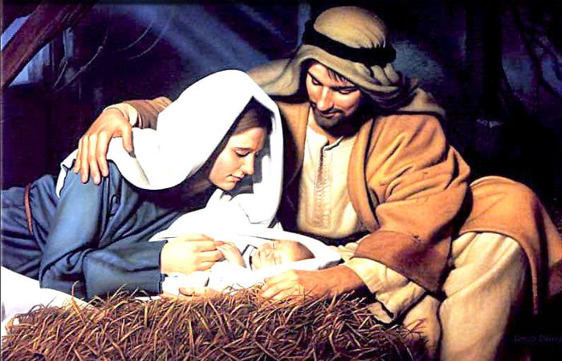
The Syro-Malabar Church, we remember and experience the Christ - mystery that forms the foundation of our salvation.
Our church has the tradition of observing abstinence for twenty-five days before Christmas. The Sunday readings of this season are related to the birth of the Savior

Slide 24

The shepherds venerated Jesus, born as the saviour of the whole world. The wise men who came in search of Jesus, having seen the star that announced his birth as the kind of the Jews, acknowledged his kingship, priesthood and divinity by offering gold, myrrh and frankincense. Let us also acknowledge Jesus as our Lord and Saviour and worship him.

Slide 25
Let us pray
O! Jesus, bless us with your grace and help us to be nourished by the fruits of your incarnation.

Slide 26
Read the word of god:
Mathew 1:18 - 2:23

Slide 27
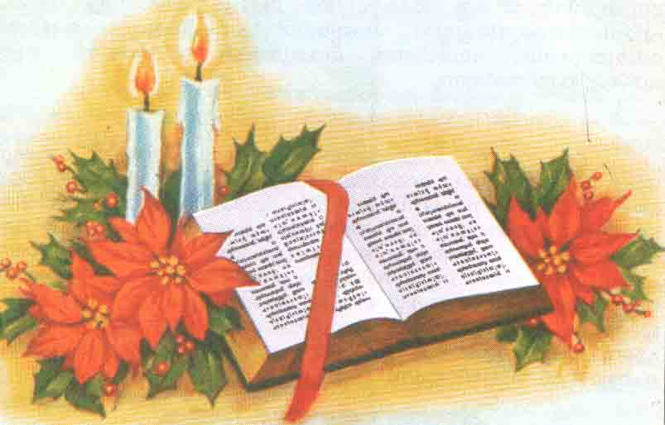
WORD OF GOD FOR GUIDANCE
Here am I, the servant of the Lord; let it be with me according to your word (Lk.1:38).

Slide 28
LET US DO:
Prepare a narration of the nativity of our Lord
based on the Gospel of St. Luke.

Slide 29
MY DECISION
I will remember daily the presence of
Jesus who resides in my heart.

Slide 30
LET US Find out the answer
1. Mention two prophecies which aroused hope among the Israelites about the coming of the Saviour?
2. Which is the song that we sing during the Holy Mass remembering the birth of Jesus?
3. What are the gifts that the wise men from the east offered to infant Jesus?
4. What are the salvific events that we commemorate during the season of Annunciation?
5. What is the attitude that we have to keep during the seasons of Annunciation- Nativity?
6. Which is the prime event in the seasons of Annunciation and Nativity?

Slide 31
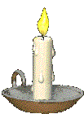


Thank you

